Slide 1
INFO 5100 : Application Engineering and Development
Lab 3 : User Process Sequencing

Slide 2
Objective
Review
Understand what an application architecture is all about
Demonstrate how to create user processes in a java/swing application
How to link a sequence of screens
How to create and populate JPanels
How to pass data between JPanels

Slide 3
What we learned so far

Slide 4
What is an Application
An Application is like a system
Made up of components and subcomponents
Designed for People (by people)
As users and subjects
Patient is the subject of an application for nurses
Built by engineers
An application solves a business problem
The “why” we need it?
An application operationalize the solution to solve the problem (running and executing program)

Slide 5
Continued
The business problem to be solved by the application must be understood first.
Example: the university wants to make its students more competitive
The application must be designed
Build a business model that describes the problem domain.
The components and how these components interact together (classes and relationships)
Example: Student, department, college, classes, teachers, etc.

Slide 6
The functional and operations of the application
The functions of the application must be understood and fully specified
We call this the functional architecture of the application
Also known as (aka) the use-cases
Also known as operations to be performed by the system
Operations can be internal (sorting a list for display)
Operations that are triggered by the user
Show me our most profitable products

Slide 7
The steps
Understand the problem to be solved
Make graduates more competitive through innovative software engineering techniques
Understand the problem domain
University, colleges, departments, students, teachers, courses, etc.
Define the business model
The domain components that are critical to solving the problem: Teachers from industry, courses that address industry needs, relationship of courses to jobs
Specify attributes on the components
Define the use-cases
Specify user-responsibilities do their jobs (user interfaces)
Design the UI
Specify the methods on the component classes that support what the user must do to fulfill their jobs

Slide 8
The steps (continue)
Map the components
Components map to java classes
Attributes map to java attributes
Strings, integers, arrays, etc.
Relationships to java collections (array lists)
Map the interface specifications on the business components into java methods
Implement the java method specs to java code logic
What We Learned So Far?

Slide 9
Problem-->Design-->Spec--Implement
Problem Definition
Challenges
Waste
Competitiveness
Design
Model Components
Attributes
Use cases/functions
Specification
Implementation
Inefficiency
High cost
Misscommunication
Component interaction
Interfaces
User responsibility to solution
Interaction between methods
Methods help each other
Modular design
Components specialize
Method Input specified
Method output specified
Java classes
Java attributes and types
Arraylist for group operations
User interact components
Interaction between swing components and java classes on the backend
Front-end (UI)
Backend (java classes)

Slide 10
Application Structure
Data
Users
Data
Roles
Data
User Processes
(Activities)
Data

Slide 11
What is a System?
The definition of system : An organized set of parts and interacting elements that perform a function that is more than the sum of its parts. A system may consist of things, people, and organizations. An important theoretical underpinning of the research presented in this thesis is that humans and social constructs are analyzed as part of the system. Humans and organizations must be analyzed beyond the ―man–machine‖ interface. Humans must be treated as part of the system because their role (job) is designed, their interactions with the system and each other are designed, and their interactions with each other create the most powerful drivers of system safety (and system risk).

Slide 12
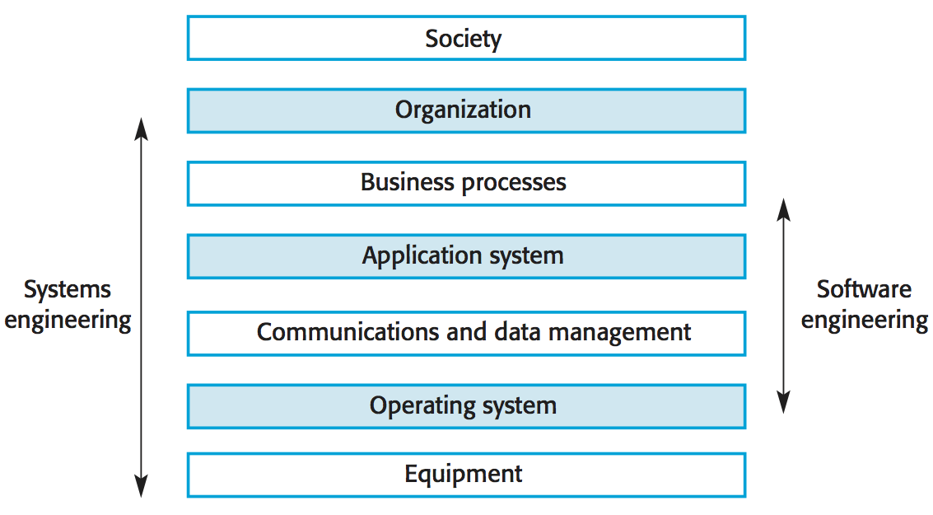
We will extend software engineering to include the social structure as well

Slide 13
Components of an Application
(User, Password)
User Screen
User Directory
User account +
role
User Interface
Role
Role 1
Role 2
Role n
…..
Person Directory
Person
Work Area
Work Responsibility 1
Activity 1, Activity 2, …
Work Responsibility 2
Activity 1, Activity 2, …

Slide 14
Application Structure (Contd.)
Role 1
Work Area
Data as input
Work Responsibility 1
Data as output
Activity 1, Activity 2, …
Work Responsibility 2
Activity 1, Activity 2, …

Slide 15
Performer Work Area
My Work Space
Major Tasks or Work Responsibilities
Top Level User Process 1
Top level User Process 2
:
:

Slide 16
Performer Work Area (option 2)
My Work Area
Major Tasks or Work Responsibilities
Top Level User Process 1
Top level User Process 2
:
:
User process steps

Slide 17
A Typical User Interface
Time
Top Level User Process
Business Task
Abort
Next

Slide 18
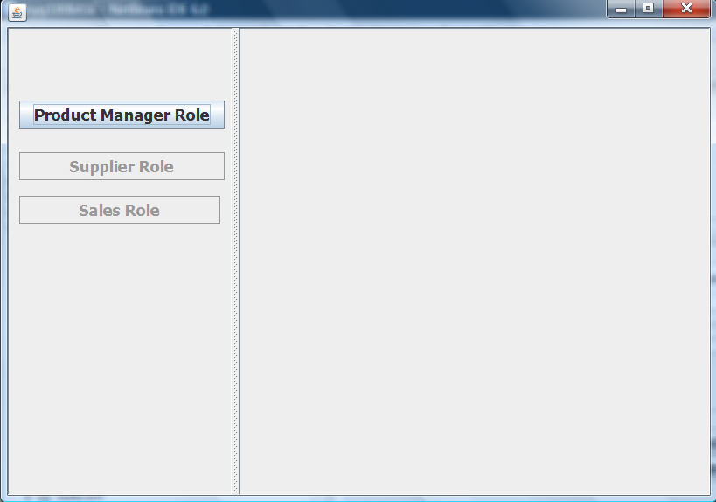
Example
1
2

Slide 19
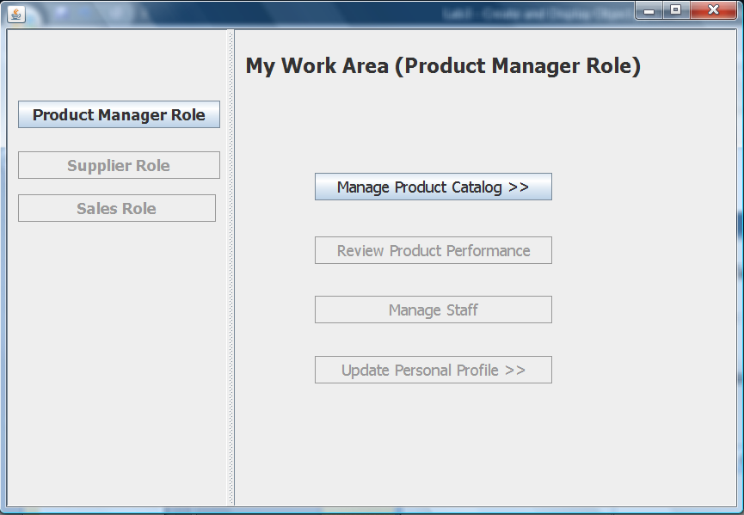

Slide 20
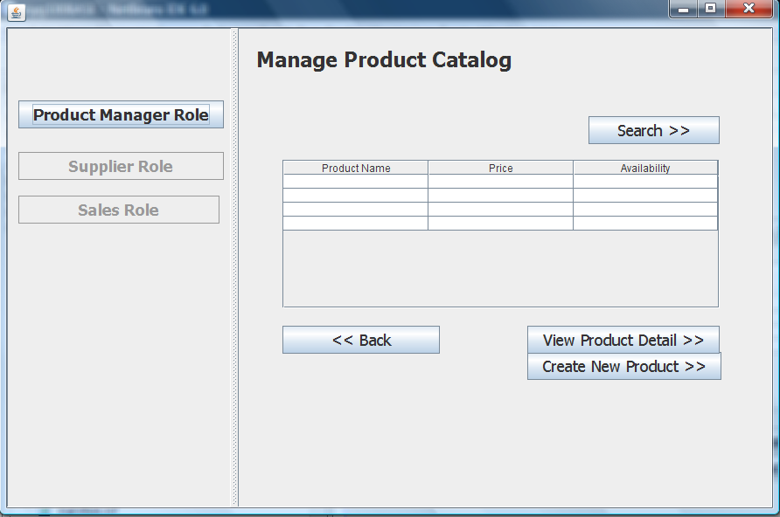

Slide 21
Output Step 2

Slide 22
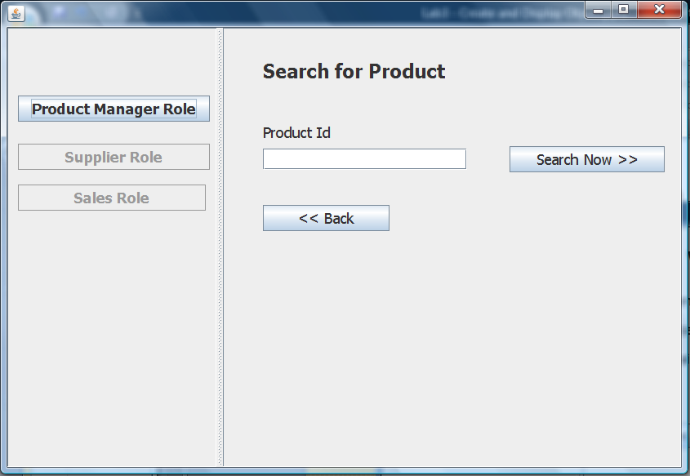
Output Step 2

Slide 23
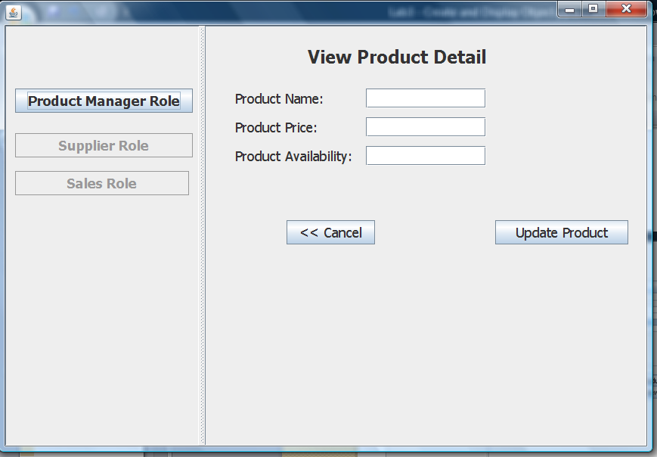

Slide 24
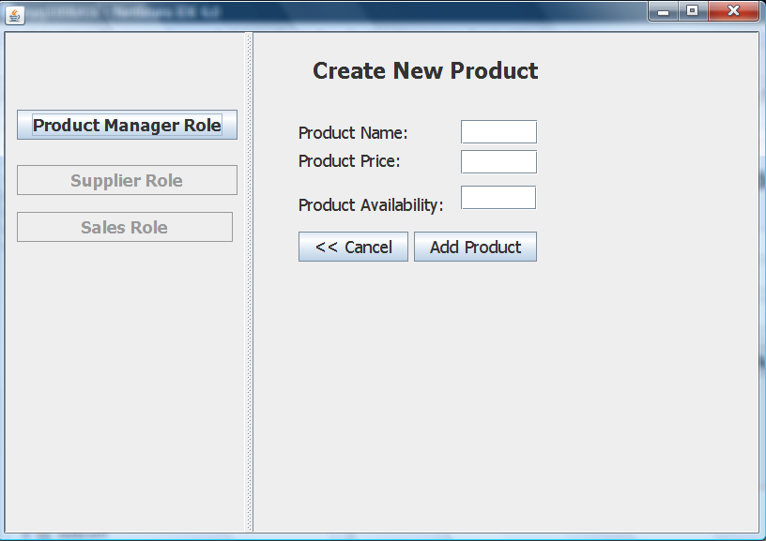

Slide 25
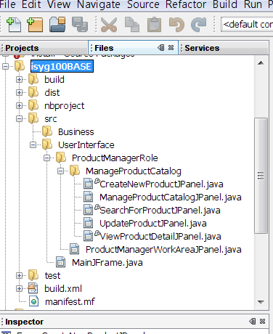
Create new project
1

Slide 26
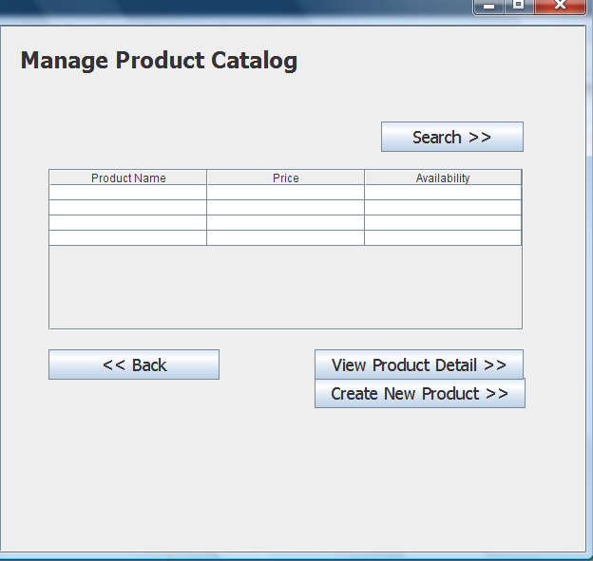
What is the input
Product Catalog

Slide 27
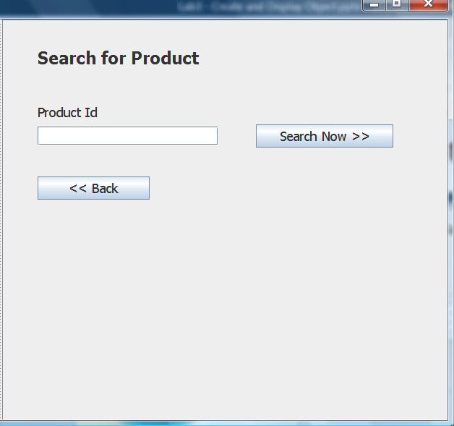
Product Catalog

Slide 28
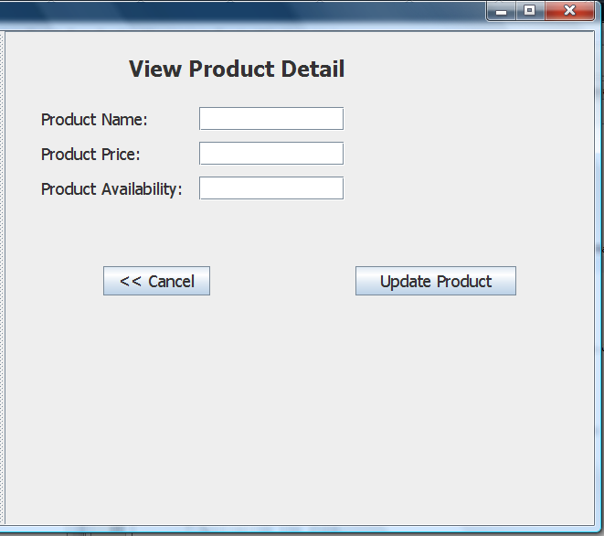
Product

Slide 29
Product
Catalog

Slide 30
Product

Slide 31
How to find selected row in table?
int rr = productcatalogtable.getSelectionModel().getLeadSelectionIndex();
if (rr < 0 || rr >= tagetsdetailstable.getRowCount()) {
return;
}
selectedproduct = (Product) productcatalogtable.getValueAt(rr, 0);

